Slide 1



schematiq
This presentation has live captioning.
Project Brief Deck
Let’s set our project up for success
Project Title:
Presented By:
Presented To:
Analysis of Top Social Media Refresh Strategies
Chidi Eze
Jackson Davis

Slide 2



schematiq
03
Overview
Objectives and Goals
Target Audience
Competition
Timeline
Stakeholders
04
Agenda
05
06
Use links to go to a different page inside your presentation.
Highlight the text you want to hyperlink, click the link symbol that appears above that text, then select from the dropdown the page that you want to connect.
07
08

Slide 3


schematiq
Overview
Introduce the project. Provide a quick background and rationale. Briefly share its overall scope as well as expected outcomes.
Drag and drop your photo or video! Click the sample photo or video and delete. Select yours from the uploads tab, drag, and then drop inside the frame!
Back to Agenda Page

Slide 4




Objectives and Goals
Clarify the project's overall objectives and goals.
Goal # 1
Goal # 2
Goal # 3
Elaborate on the
first goal here.
Elaborate on the
second goal here.
Elaborate on the
third goal here.
Back to Agenda Page
schematiq

Slide 5




Target Audience
Target Audience #1
List their key details.
Identify the key audiences for which the project is intended.
Target Audience #2
List their key details.
Target Audience #3
Drag and drop your photo or video! Click the sample photo or video and delete. Select yours from the uploads tab, drag, and then drop inside the frame!
List their key details.
Back to Agenda Page
schematiq

Slide 6
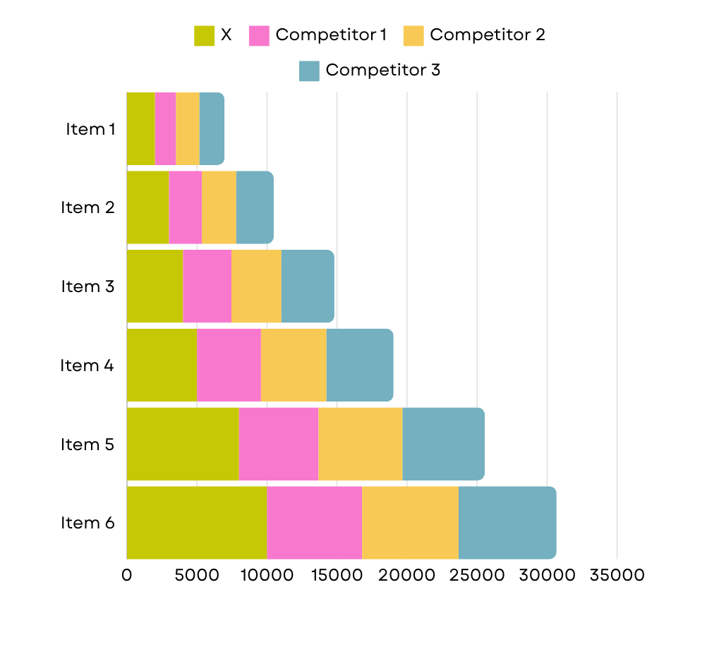
Competition
Introduce the company's main competitors.
Competitor #1
Write an observation about the competitor.
Competitor #2
Write an observation about the competitor.
Competitor #3
Write an observation about the competitor.
Back to Agenda Page
schematiq

Slide 7


Briefly discuss the key dates for the project.
1st Quarter
List a milestone or deadline.
2nd Quarter
Timeline
List a milestone or deadline.
3rd Quarter
List a milestone or deadline.
4th Quarter
List the expected wrap-up
date for the project.
Back to Agenda Page
schematiq

Slide 8


Stakeholders
Identify the important stakeholders concerned with the project.
 | Internal Stakeholder | External Stakeholder | Priority Stakeholder
Stakeholder Name
Stakeholder Name
Stakeholder Name
Customize this table! Just right-click on any cell to see all the available table functions.
To merge, highlight first two or more cells, then click "Merge Cells" to organize your table according to your needs!
Back to Agenda Page
schematiq

Slide 9




Drag and drop your photo or video! Click the sample photo or video and delete. Select yours from the uploads tab, drag, and then drop inside the frame!
Thank you all for going through this project brief.
Best of luck!
Back to Agenda Page
schematiq

Slide 10
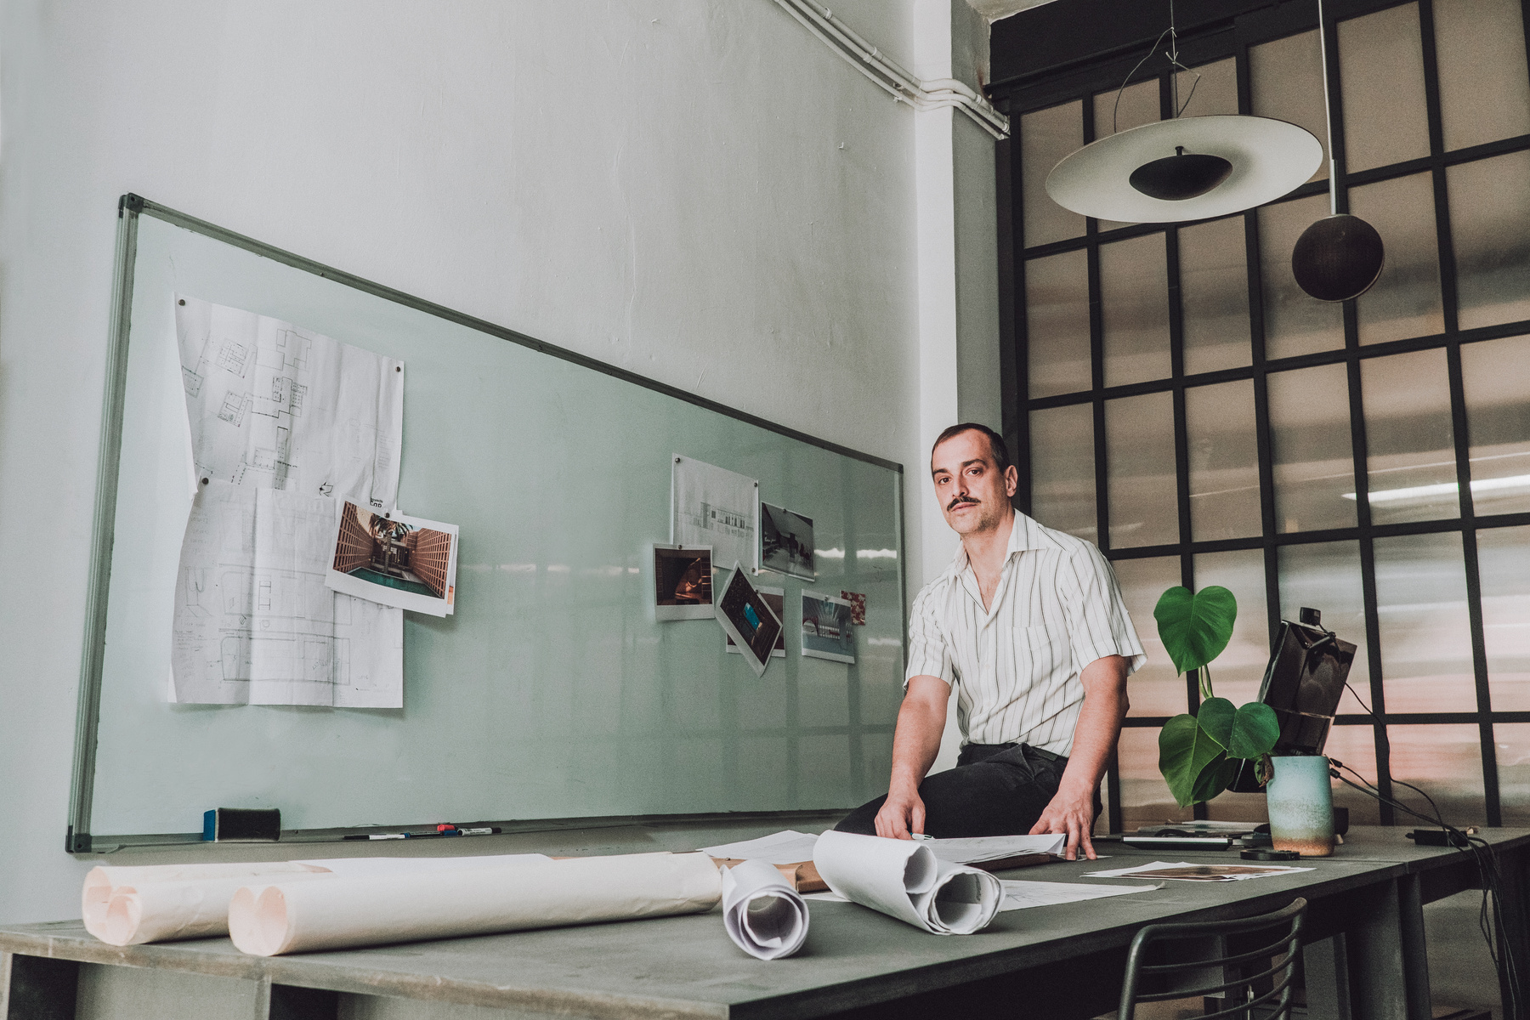


For questions, reach out to:
Project
Manager's Name
Add role
@reallygreatsite
hello@reallygreatsite.com
Project
Manager's Name
Add role
@reallygreatsite
hello@reallygreatsite.com
schematiq

Slide 11




Whiteboard Page
Press "S" to create sticky notes.
Write a note here
Write a note here
Tip: Collaboration makes teamwork easier! Click "Share" and invite your teammates to fill this up. Use this page for bulletins, brainstorms, and other fun team ideas.
Right-click on the background of the slide, or on the thumbnail below, for the option to expand this page into a whiteboard for more space!
Copy a note, drag to the board, and write your ideas.
Copy a note, drag to the board, and write your ideas.

Slide 12

Add even more
sub-ideas
Add even more
sub-ideas
Add more
sub-ideas
Brainstorm better!
Set a time limit for yourself for a more focused brainstorming session.
Add more
sub-ideas
Add a related idea
Add a main topic
Add a related idea
Add a related idea
Add more
sub-ideas
Add a related idea
Tip: Collaboration makes teamwork easier! Click "Share" and invite your teammates to fill this up. Use this page for bulletins, brainstorms, and other fun team ideas.
Right-click on the background of the slide, or on the thumbnail below, for the option to expand this page into a whiteboard for more space!
Add even more
sub-ideas
Add even more
sub-ideas
Add more
sub-ideas

Slide 13






























Resource Page
Use these design resources in your Canva Presentation.
Happy designing! Delete or hide this page before presenting.

Slide 14












Resource Page
Use these design resources in your Canva Presentation.
Happy designing! Delete or hide this page before presenting.

Slide 15


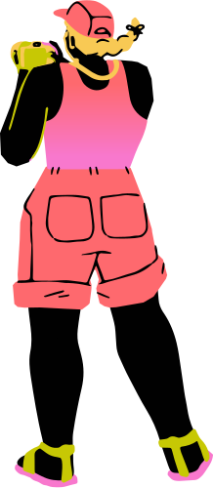




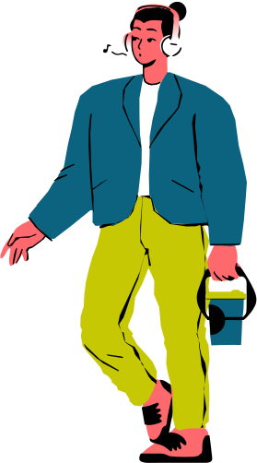



Resource Page
Use these design resources in your Canva Presentation.
Happy designing! Delete or hide this page before presenting.

Slide 16

Resource Page
Find the magic and fun in presenting with Canva Presentations. Press the following keys while on Present mode!
Delete or hide this page before presenting.
O for bubbles
C for confetti
U for unveil
Q for quiet
D for a drumroll
B for blur
Any number from 0-9 for a timer
M for mic drop

Slide 17

Resource Page
Click the Share button on the top right corner of your screen and select 'Present and Record.'
Click ‘Go to recording studio,’ where you can choose the video and audio source for your video presentation.
Feel free to choose the ‘No camera’ option and record your voice only.
Start recording, and press pause in between takes if you have to.
Once you're done, download your Canva Presentation in MP4 file format or get a link to your Talking Presentation and share it with others.
You can also record a video inside the editor! Go to 'Uploads' and click on 'Record yourself'.
Presenting live not your thing? No worries! Record your Canva Presentation your audience can watch at their own pace.
Don't forget to delete or hide this page before presenting.

